Slide 1
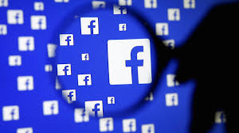
Facebook News Article analysis by Category
Jake Taylor
Anthony English
LIKEs, Shares, Comments
Emotional Reactions
Clickbait Status

Slide 2
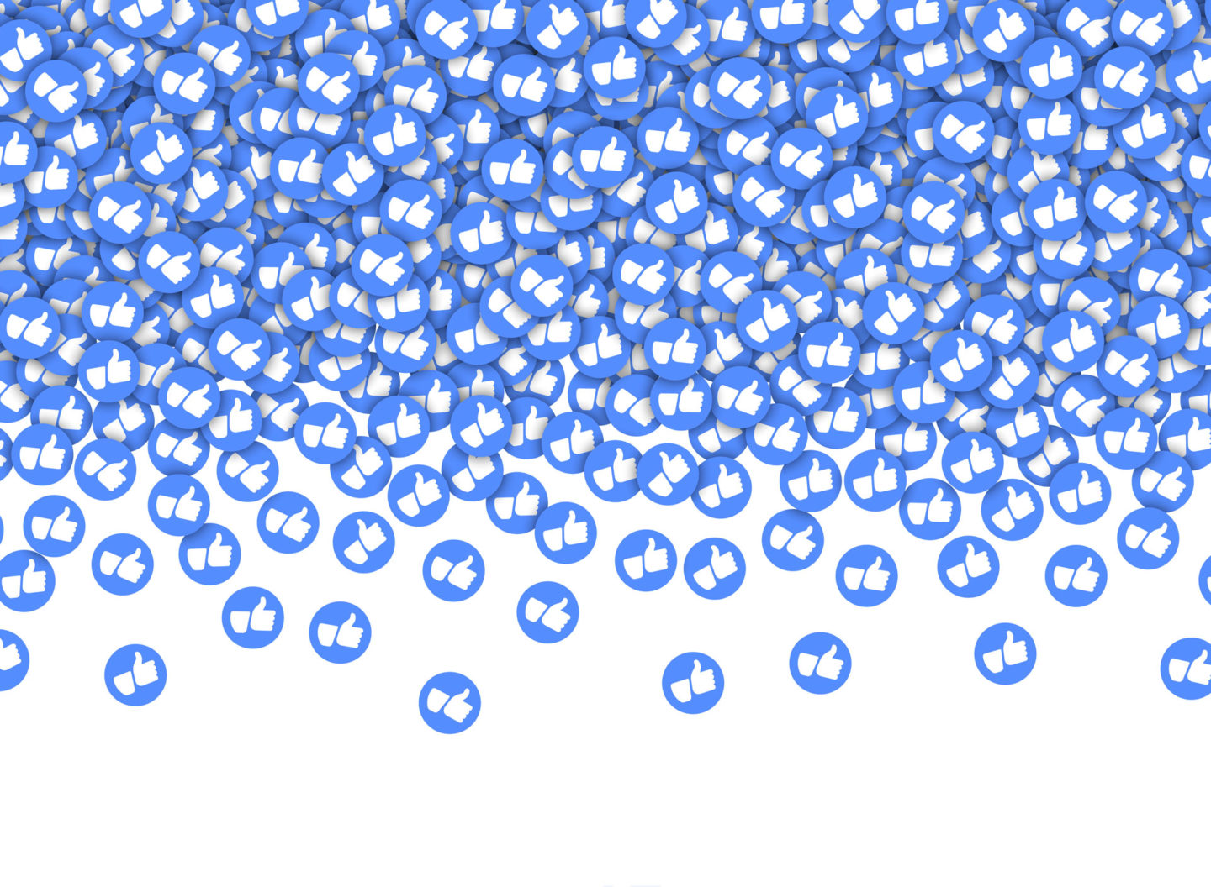

Idea Concept
A news article’s title and category has a large impact on its popularity on Facebook
Do certain article categories have more popularity than others?
Are there certain trends for emotional reactions to articles?
Part 1 – Anthony English
Part 2 - Jake Taylor
Do results with clickbait titles have more success than those with representative titles?
Are their certain news sources that produce more clickbait?

Slide 3


Data Set
Buzzsumo website search for top performing news articles in 10 different categories.
10,000 Most popular news articles on Facebook and other social media during the past 6 months.
6 General categories - (Entertainment, Food, Health, Politics, Science, Sports)
4 Specific “Hot Button” categories during the first half of 2020. - (Covid, BLM, Trump, Biden)
10 .csv files were exported for each category and used for our analysis.

Slide 4

Part 1 Questions
What article categories are the most popular?
How do emotional reactions differ by article category?
How do reactions to articles on Biden and Trump differ?
Is there a relationship between emotional reactions and how much people share articles?

Slide 5
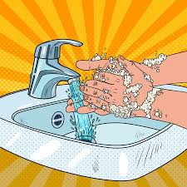
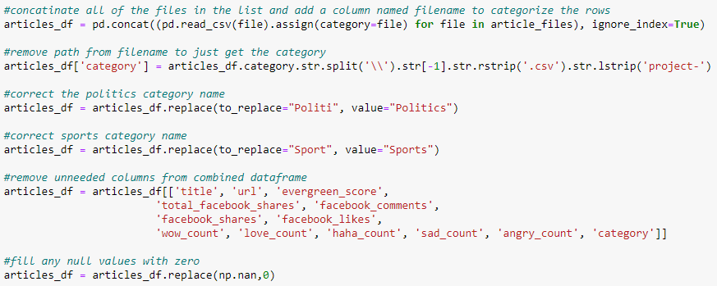
Data CleAning
Combined 10 .CSV files into one dataframe.
Removed unnecessary columns.
Stripped the url and file path from the news source and article category columns.
Replaced any null values with zeros.
Determined clickbait status and added to dataframe.
Decided not to delete duplicate articles that are in more than one category.

Slide 6

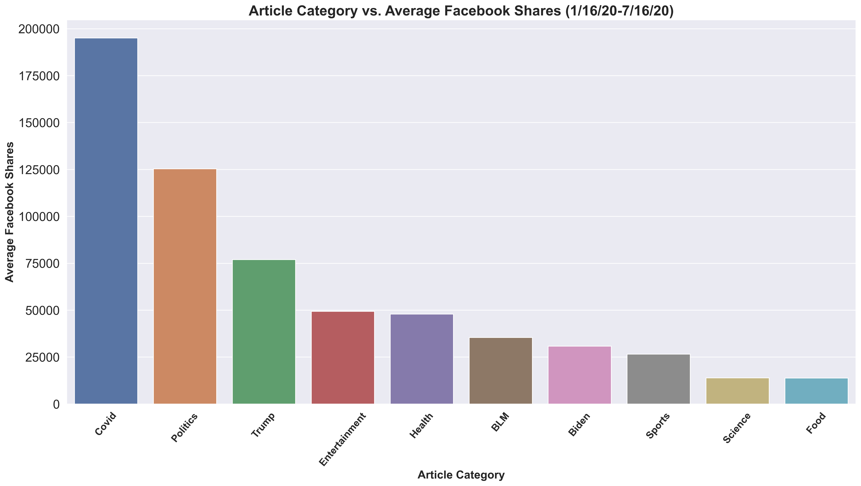
Overall Facebook Shares
Covid-19 Articles dominate the first half of 2020.
Trump has more than twice as many shares as Biden.

Slide 7
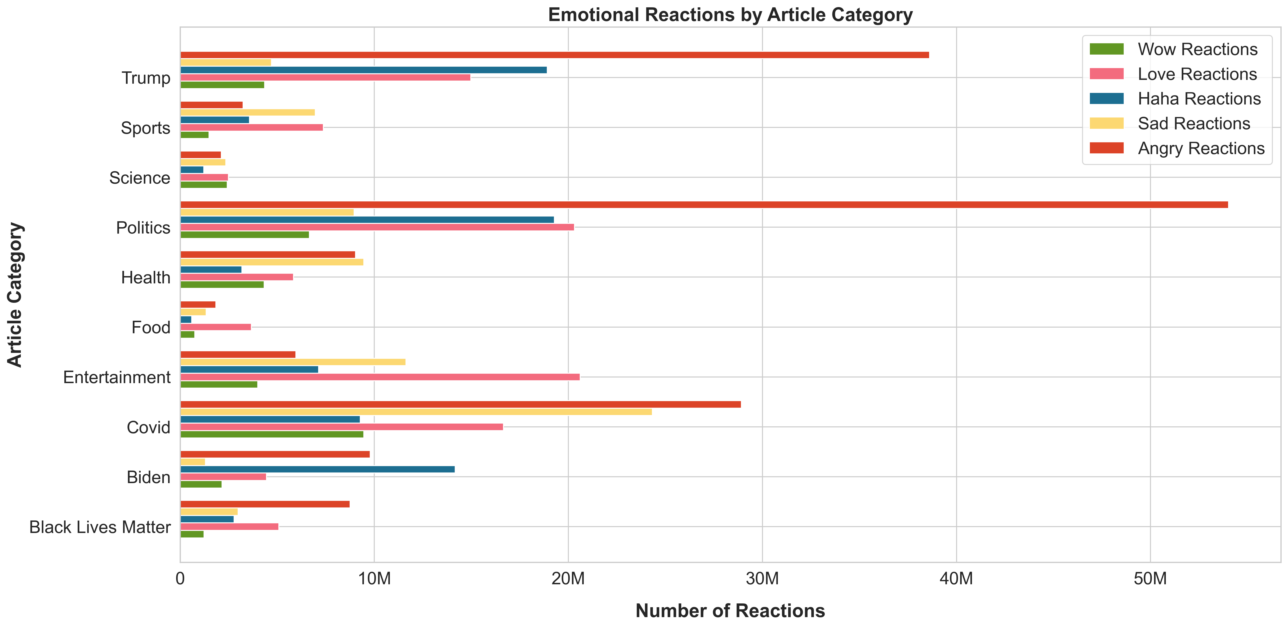






Slide 8
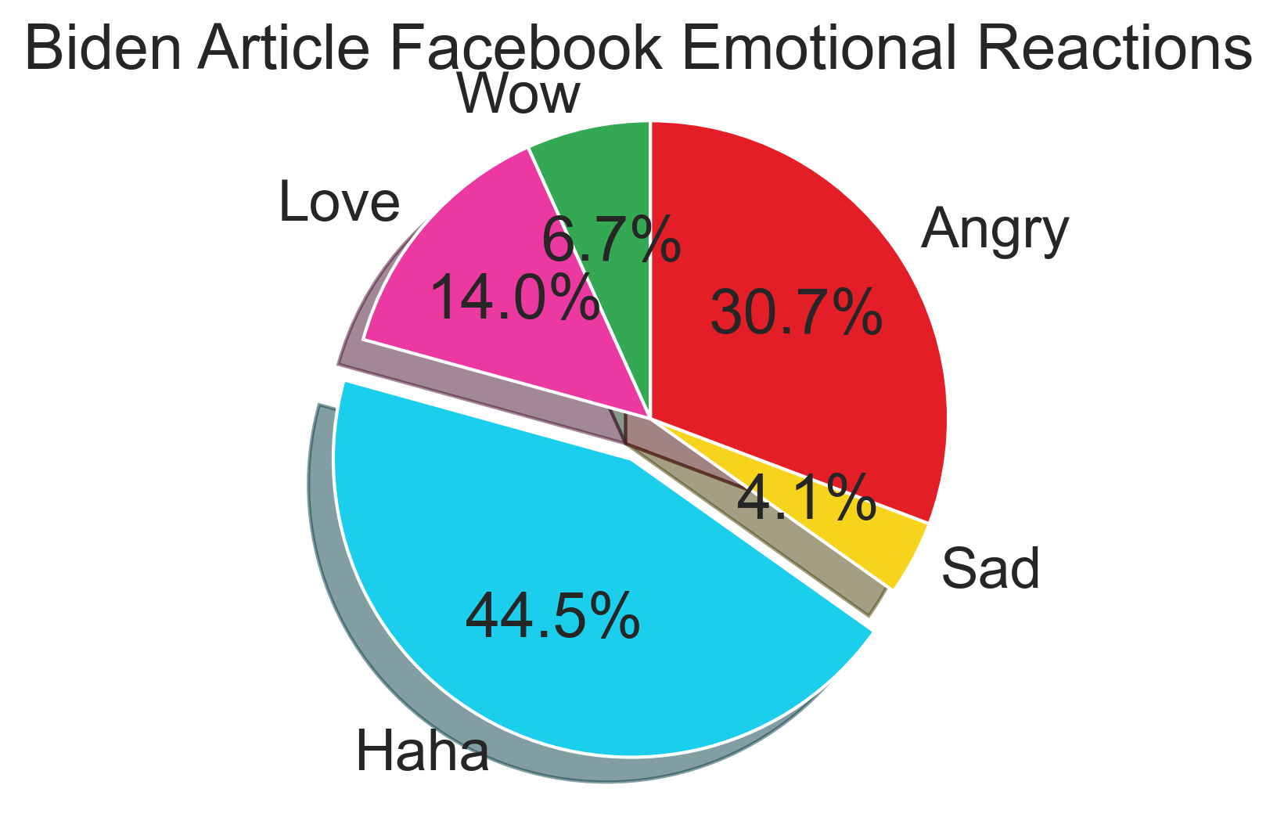
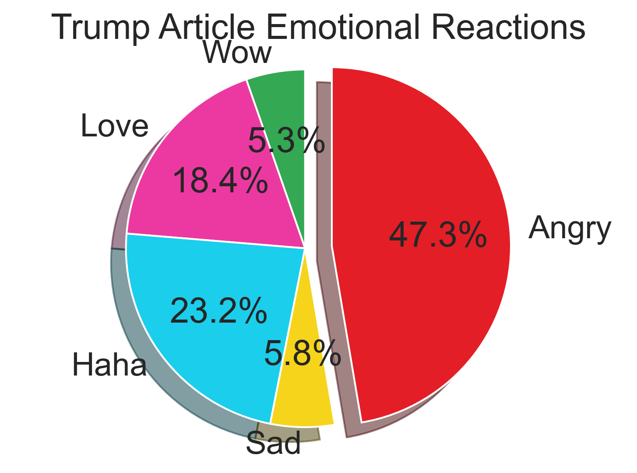
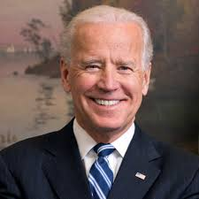

Biden vs. Trump emotional reactions

Slide 9
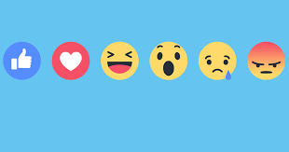
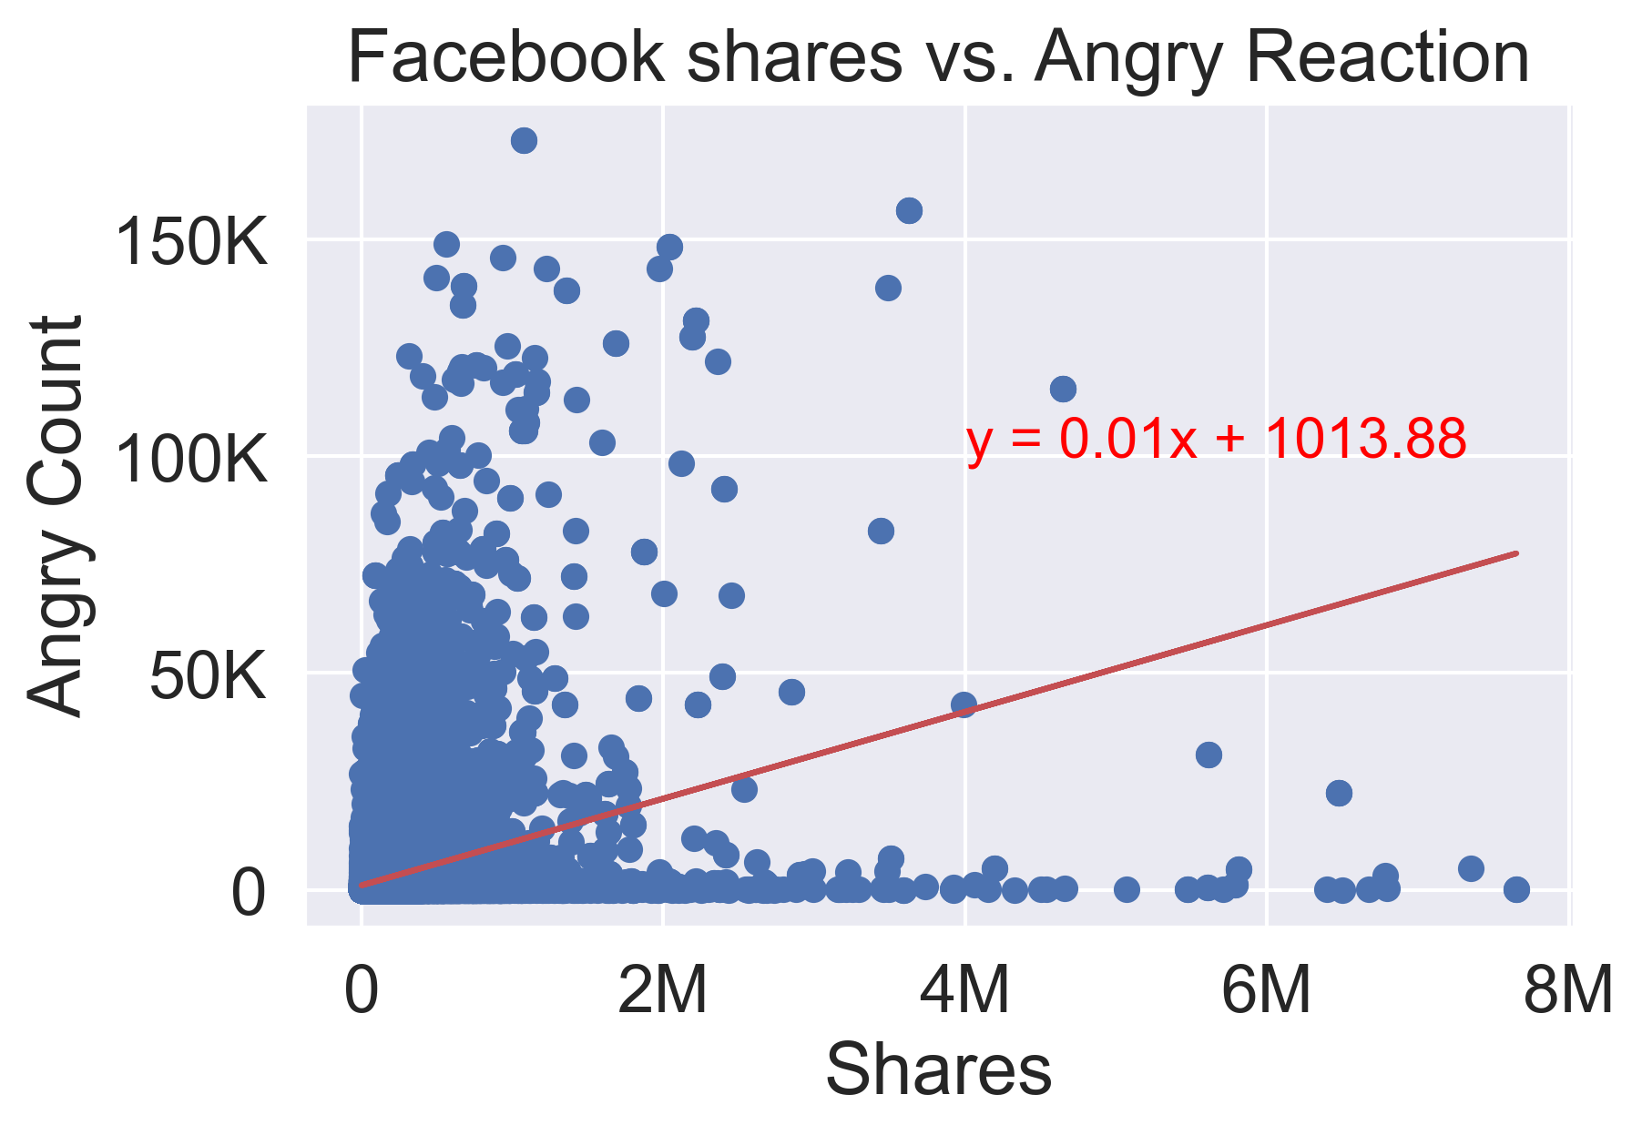
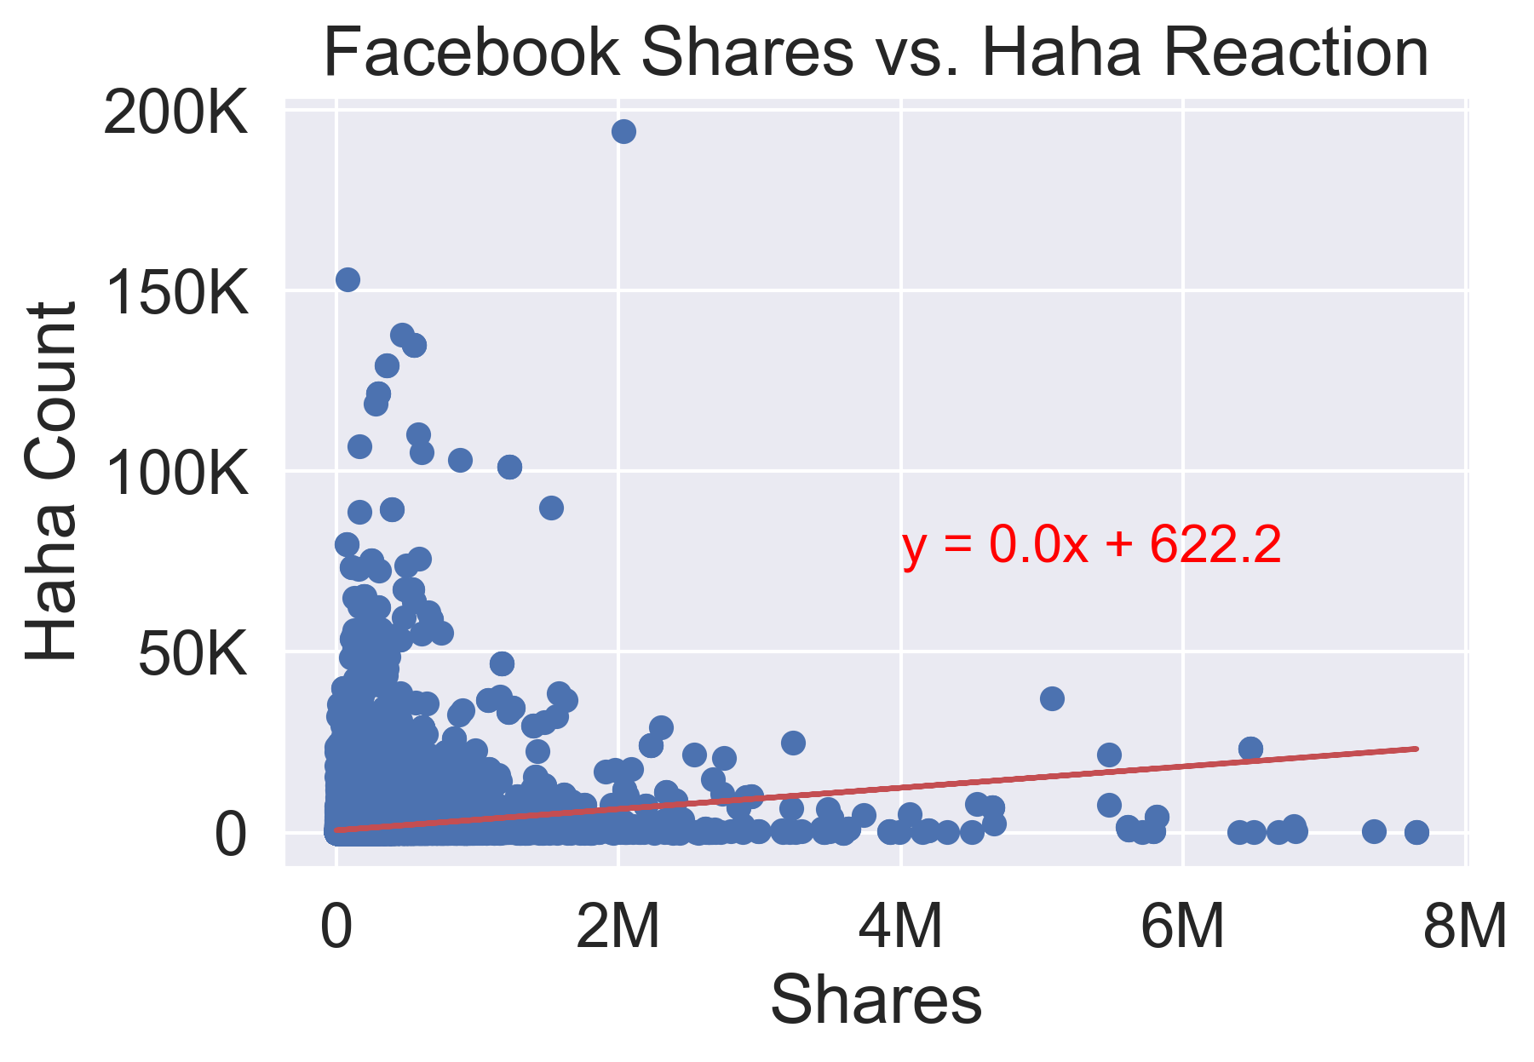
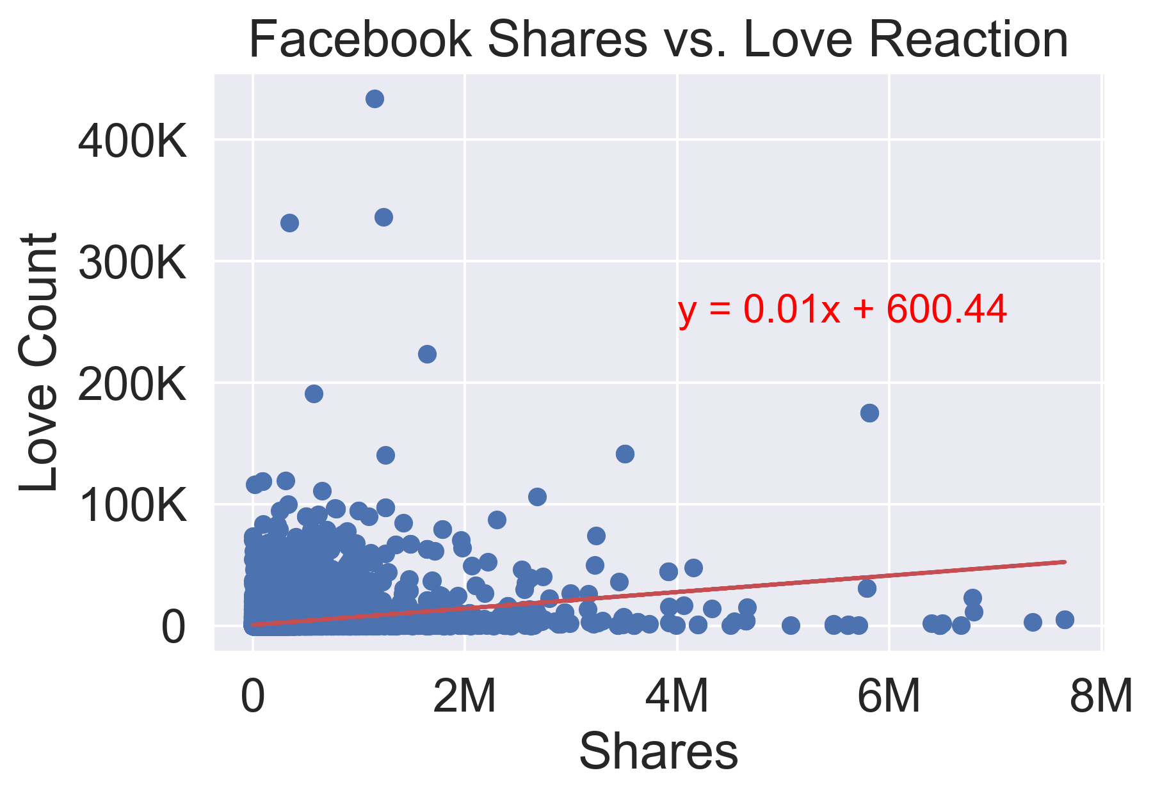
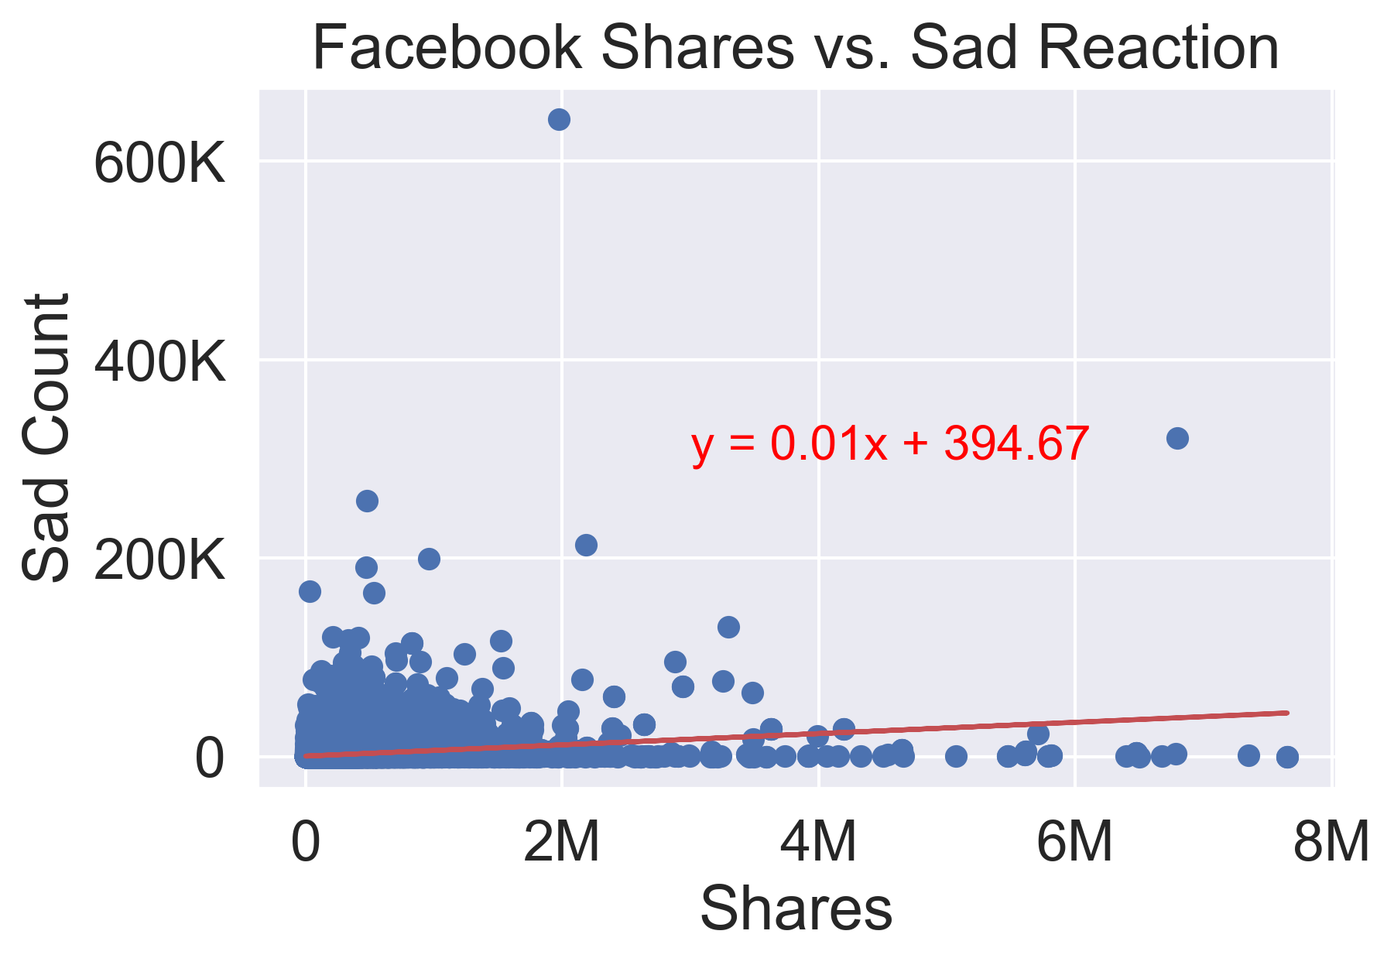
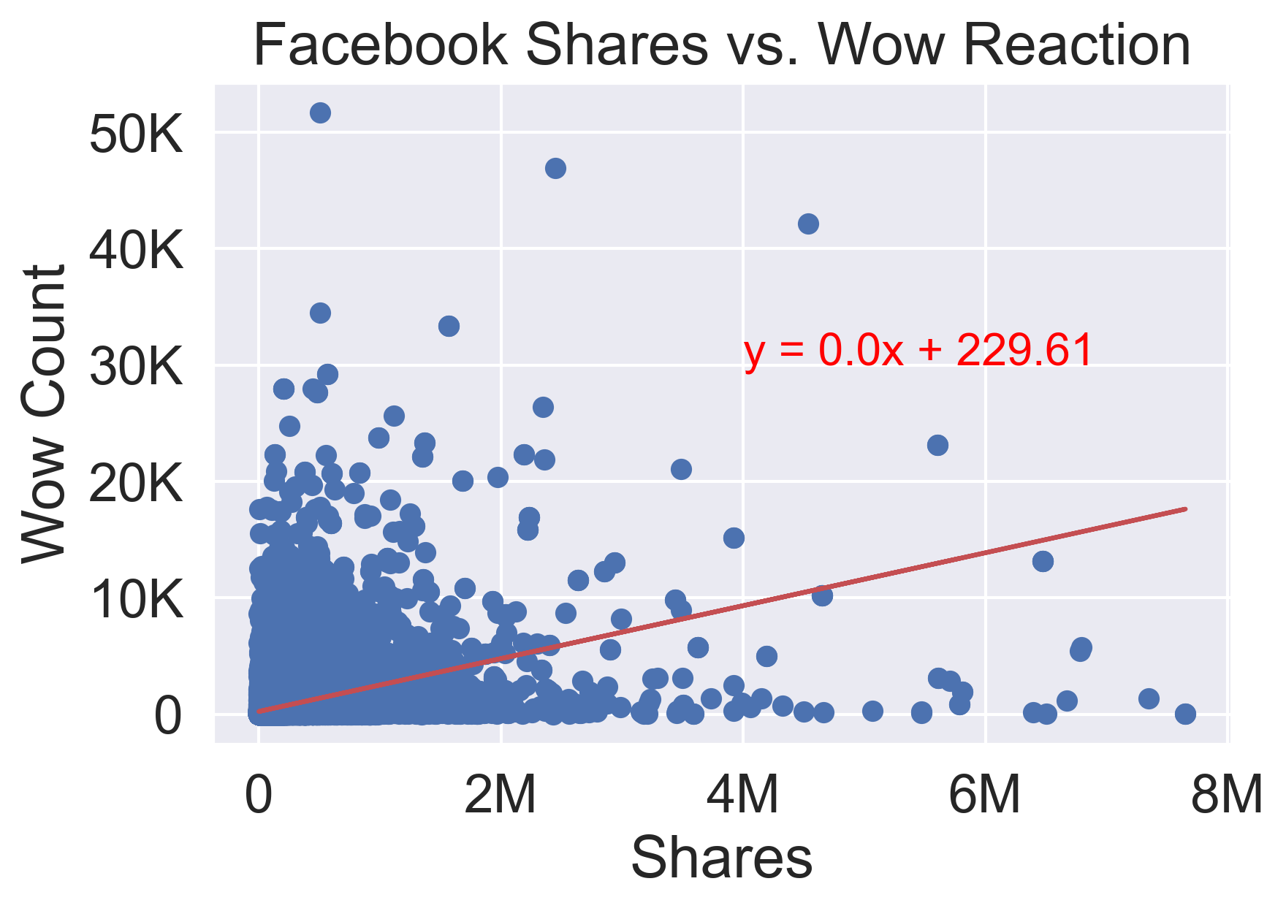
Facebook Article Shares Compared to Emotional Reactions
Correlation .30
Correlation .16
Correlation 0.28
Correlation .24
Correlation .38

Slide 10

What article categories are the most popular?
How do emotional reactions differ by article category
How do reactions to articles on Biden and Trump differ?
Is there a relationship between emotional reactions and article shares?
Conclusion 1
Conclusion 2
Conclusion 3
Conclusion 4
Covid-19 Articles have been the most liked, shared and commented on by far so far this year.
Anger is the most common reaction by far for most articles. The exceptions are Entertainment and Biden.
Trump tends to provoke Anger while Biden provokes a Haha reaction.
There is not a significant relationship between emotional reactions to an article and number of shares.
01
02
03
04
Conclusions for Part 1
Likes and Emotional Reaction Analysis

Slide 11
Pt. II
Clickbait
Do results with clickbait titles have more success than those with representative titles?
Which news sources/platforms publish the most ‘clickbait-y’ content?

Slide 12
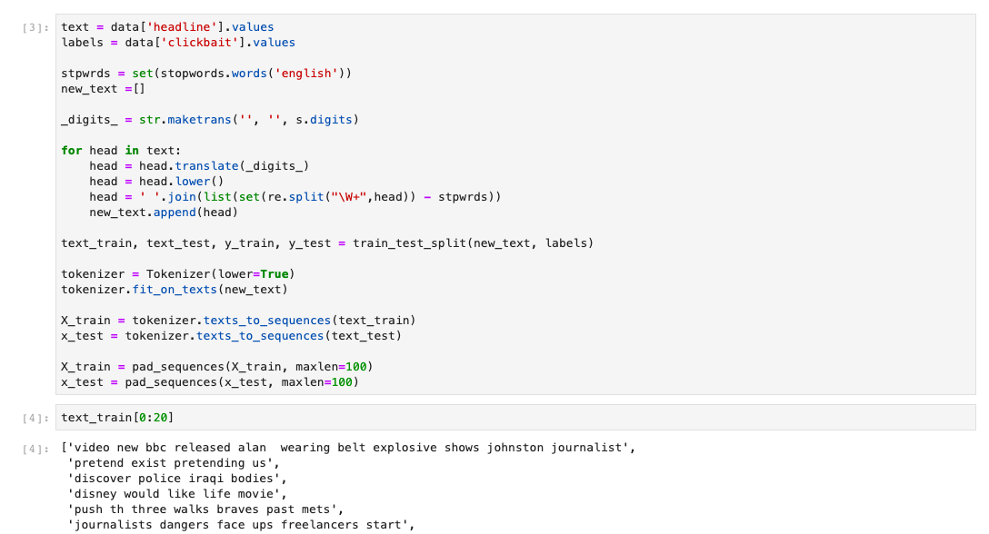
Training the clickbait detector
The data used to train the algorithm was a set of 32,000 headlines, split 50/50 into ‘Clickbait’ and ‘Not Clickbait’

Slide 13
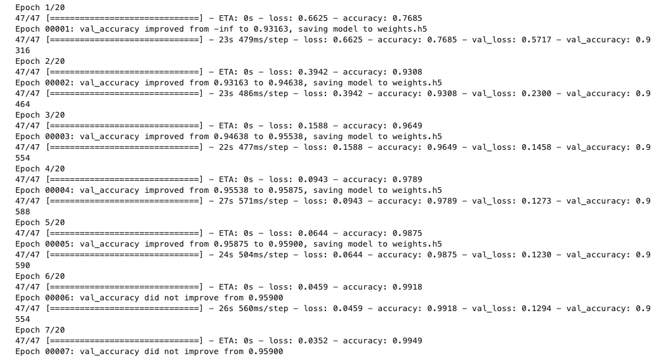
Tensorflow
We used TensorFlow, an open source machine learning platform, to train the detector

Slide 14
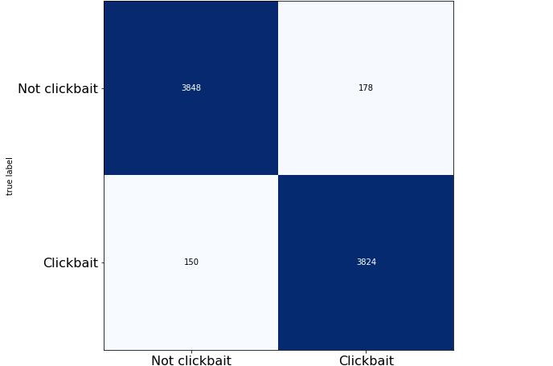

Precision

Slide 15
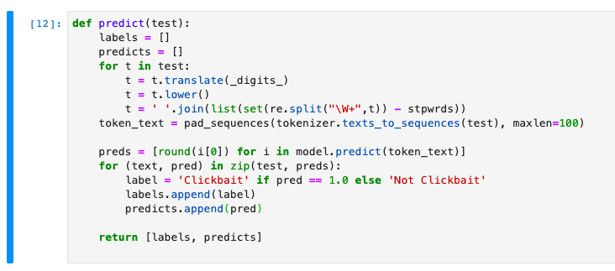
Predictions
Satisfied with the model, we created a function to test every headline in our Buzzsumo database

Slide 16
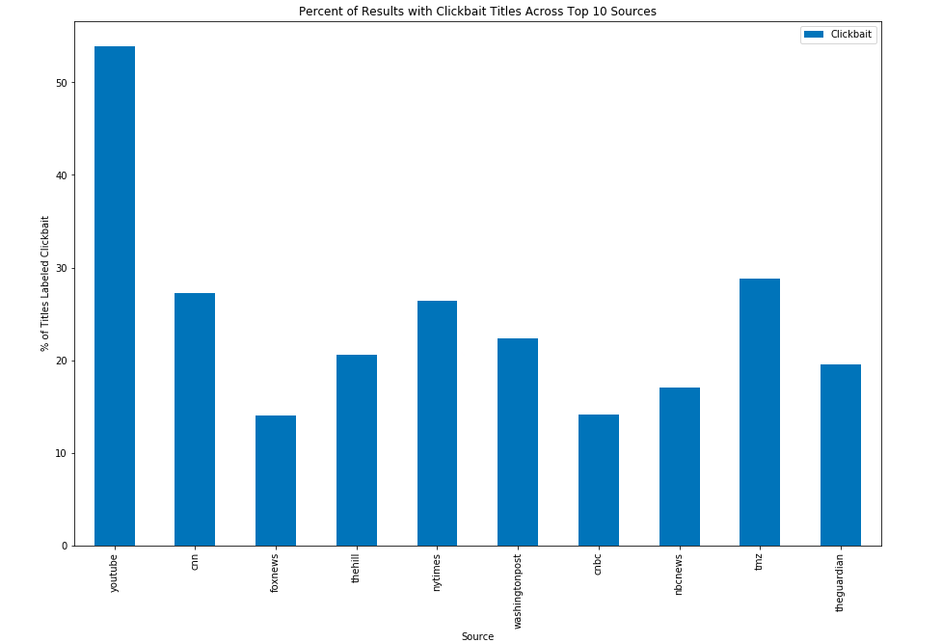

Slide 17
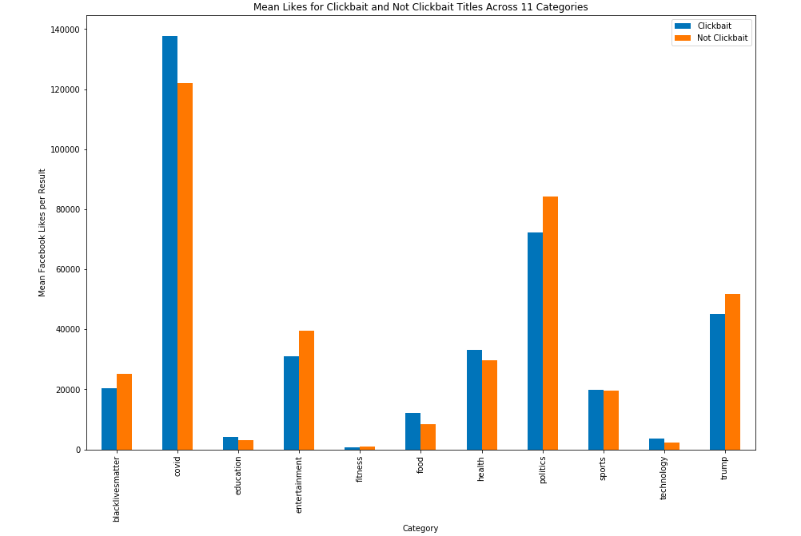

Slide 18
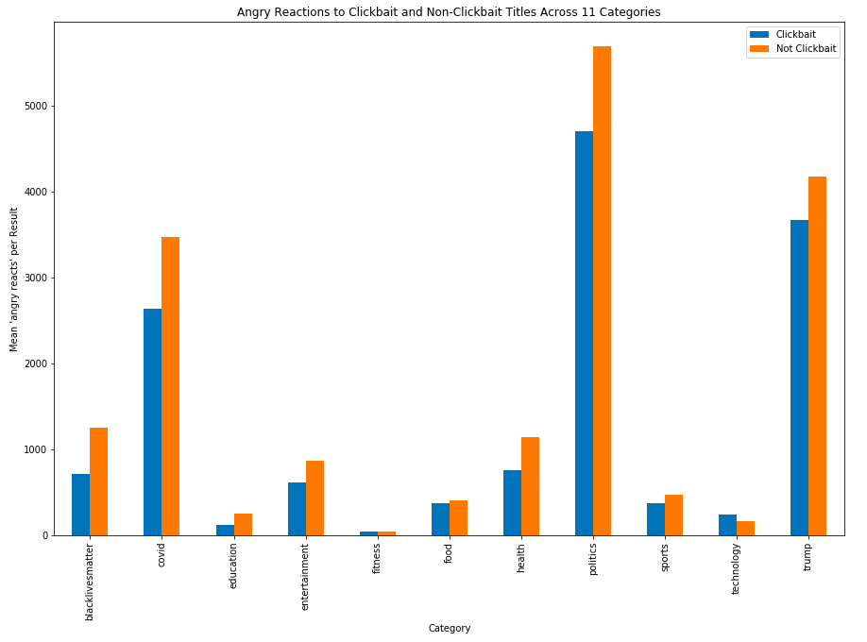

Slide 19
Questions

